Slide 1

Smart Energy Consumption Analysis
PRESENTER: Rama Subrahmanyam

Slide 2

Key Challenges in Energy Consumption
NEED FOR OPTIMIZATION
The increasing demand for energy is leading to inefficiencies and necessitating advanced methods for optimizing consumption and forecasting future needs.

Slide 3
Proposed Solution Overview
LSTM MODEL
WEB DASHBOARD
INTERACTIVE VISUALIZATION
The system utilizes an LSTM model for accurate predictions, effectively handling sequential data and capturing temporal dependencies in energy consumption.
A user-friendly web dashboard provides real-time predictions, enabling users to visualize energy consumption trends and make informed decisions effortlessly.
Interactive visualizations enhance user engagement, allowing for dynamic exploration of energy data and facilitating deeper insights into consumption patterns.

Slide 4

Technology Stack for Energy Prediction System
COMPONENTS AND FRAMEWORKS
The system leverages a robust technology stack including Python, TensorFlow, Flask, and Chart.js for seamless energy prediction and visualization.

Slide 5
System Architecture Overview
DATA COLLECTION
DATA PREPROCESSING
MODEL DEVELOPMENT
The initial phase involves importing raw datasets, followed by comprehensive cleaning to ensure data quality and relevance for analysis.
In this stage, data normalization, sequence generation, and train-test splitting are performed to prepare data for the model training process.
The model development focuses on constructing LSTM layers, optimizing the dense output layer, and minimizing loss using the Mean Squared Error function.

Slide 6
Model Development Details
INPUT FORMAT
MODEL TYPE
LOSS FUNCTION
The model utilizes 7-day weekly energy sequences as input, allowing it to capture and analyze consumption patterns effectively.
This system employs LSTM (Long Short-Term Memory) networks, optimized for learning from sequential data, enhancing prediction accuracy over time.
The Mean Squared Error (MSE) is used as the loss function, facilitating effective training by measuring prediction accuracy during model development.

Slide 7
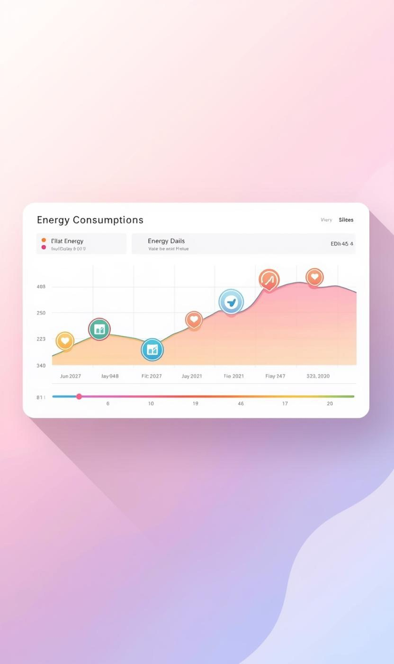
Weekly Energy Consumption Prediction Dashboard
USER INTERFACE AND OUTPUTS
The dashboard allows users to input their energy values while displaying predicted next-day consumption through interactive visualizations and trends.

Slide 8
Challenges and Solutions in Forecasting
INTEGRATION ISSUES
Integrating the model with the web platform is complex. Deploying a Flask API streamlines this process, ensuring seamless communication between the model and user interface.
DATA HANDLING
Handling sequential data is a significant challenge. The LSTM architecture provides an effective solution, enabling accurate predictions from historical energy consumption data.

Slide 9
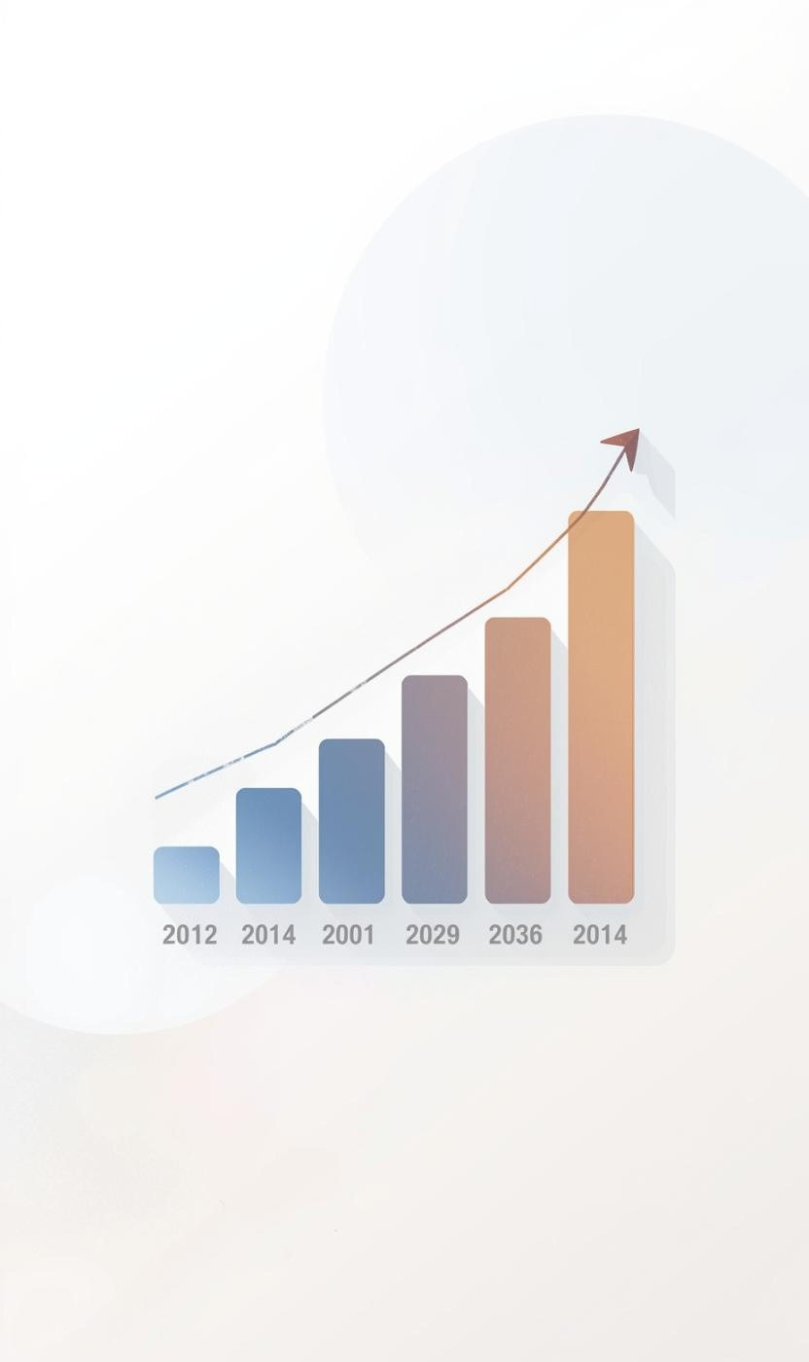
Measurable Outcomes of the Energy Prediction System
IMPACT AND BENEFITS
The system significantly enhances forecast accuracy, enabling better energy management and faster decision-making for sustainable consumption practices.

Slide 10
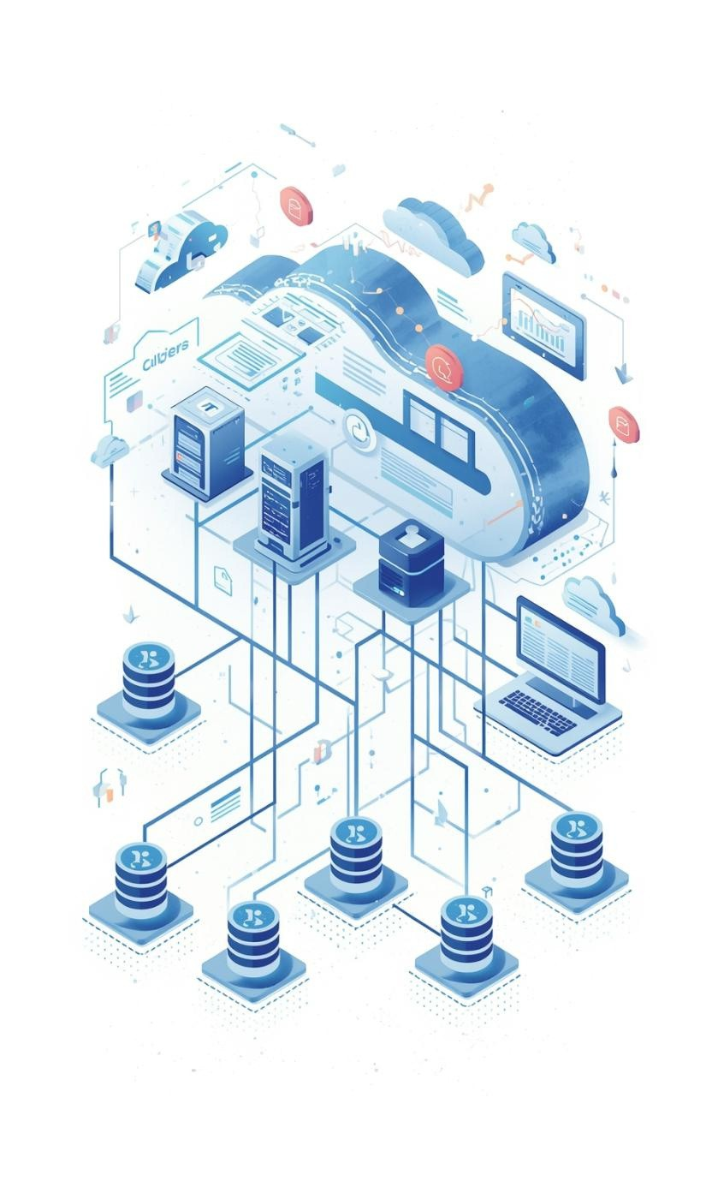
Future Enhancements for Energy Prediction System
PLANNED IMPROVEMENTS AHEAD
We aim to integrate AI-based optimization and enhance the dashboard for a more comprehensive analysis of energy consumption trends.

Slide 11
Thank You!

